Slide 1
The Global Conflict: Allied Successes
Occupied Lands
Nazi Europe
Occupied lands were an economic resource to be exploited
Nazis stripped countries of works of art and factories
Slavs, other minorities worked as slave laborers in German war industries
Nazis took revenge on resistance movements (torture, murder)
Notes:
Gold Teeth in concentration camps were removed
Pianist – resistance in the ghettos
The resistance was always outmanned
Nazi Map

Slide 2
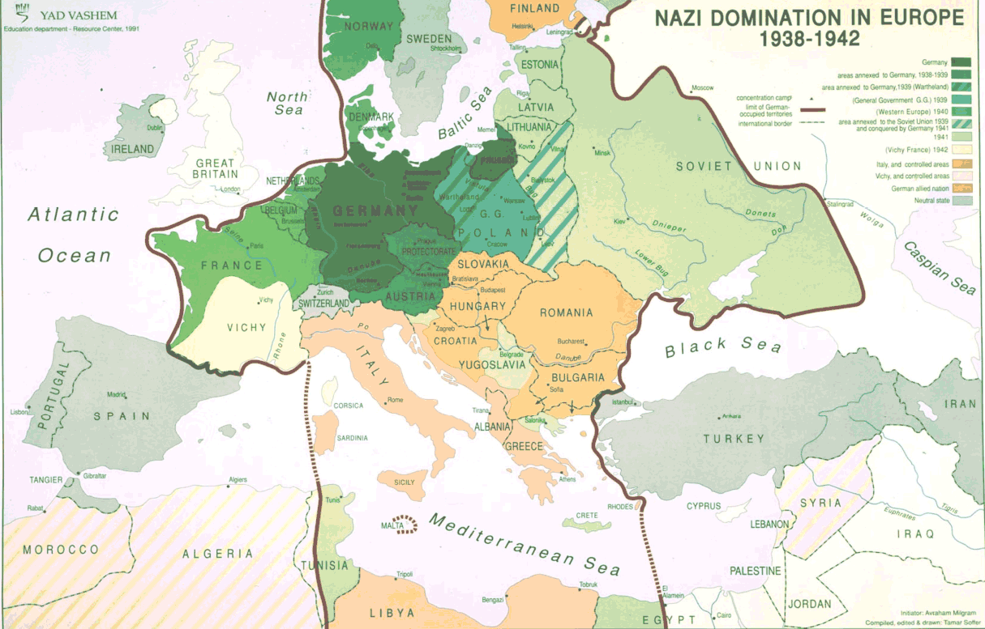

Slide 3
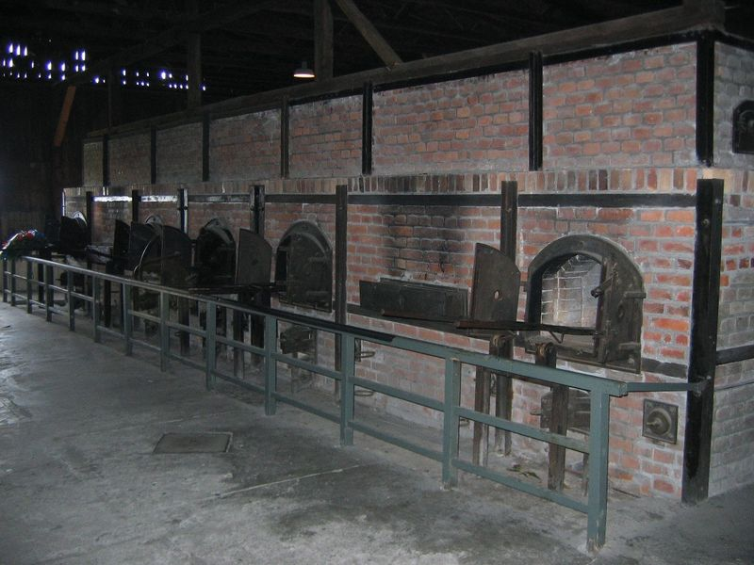
The Global Conflict: Allied Successes
Nazi Genocide
By 1941, Nazis devised plans for the “final solution” (genocide of all European Jews)
Concentration or “death” camps built in Poland and Germany (such as Auschwitz, Bergen Belsen, Dachuau)
Jews became slave laborers, some used in medical experiments, others were shot or killed in gas chambers
Notes:
Who knows what Genocide is?
Who remembers what the Nuremberg laws were?
How about the Ghettos?
Numbers tattooed on their arm at Aushwitz
Talk about Dr. Death
As well as how a gas chamber worked – Fog machine somehow?

Slide 4
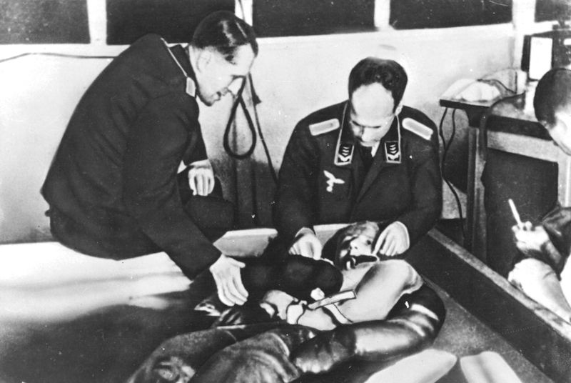

Slide 5
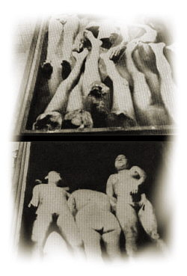
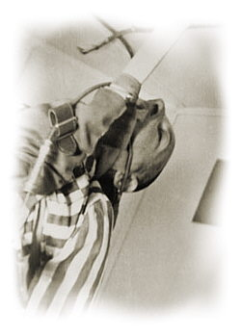

Slide 6
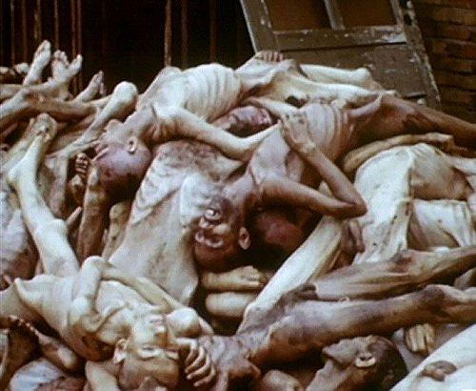

Slide 7
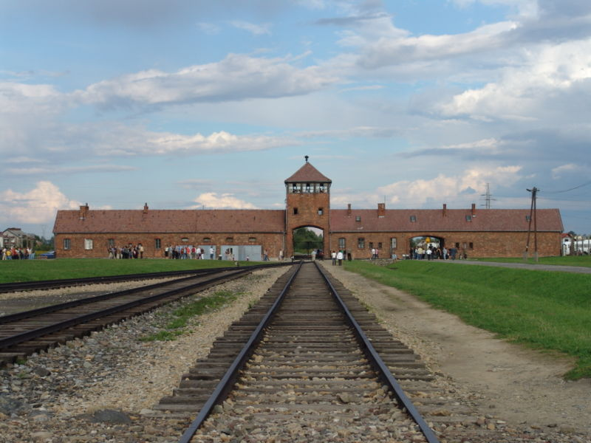
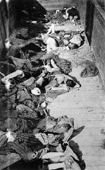
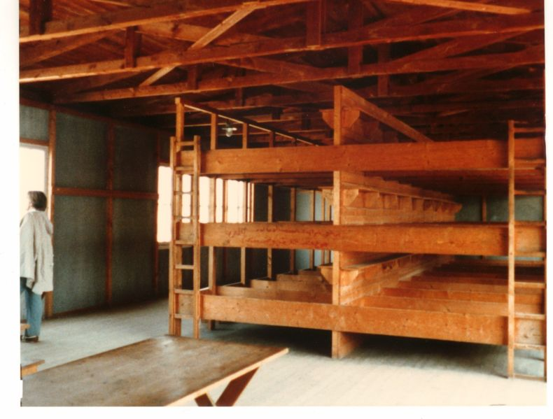

Slide 8
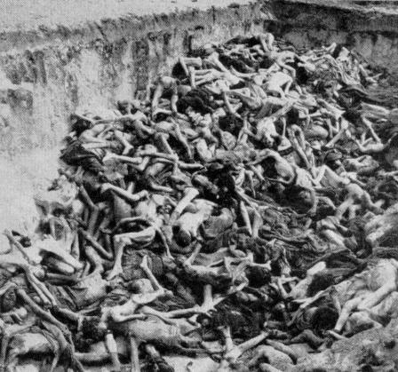

Slide 9
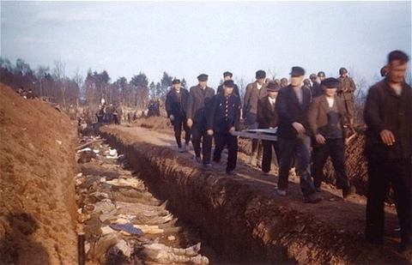
The Global Conflict: Allied Successes
By 1945, over 6 million Jews killed – massacre became known as the Holocaust
Almost 6 million other “undesirable” people killed as well
Some Jews rebelled against Nazis, but efforts were unsuccessful
Notes:
Sophie Scholl – White Rose – executed by guillotine

Slide 10
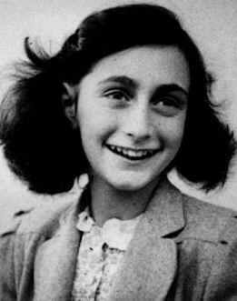
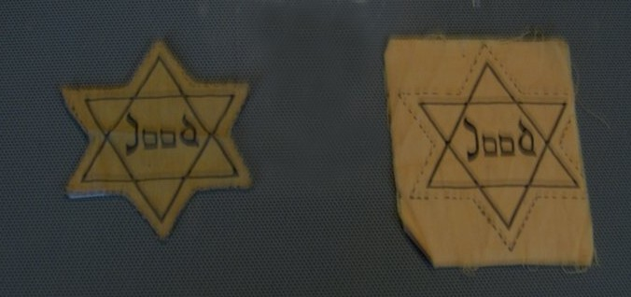
The Global Conflict: Allied Successes
Some non-Jews helped hide Jews from the Nazis, while others were collaborators, helping the Nazis hunt down Jews
a. Vichy France sent 10’s of 1,000s of Jews to concentration camps
Notes:
Anne Frank
Stop on this slide – Continue Video
Band of Brothers “Why we Fight”

Slide 11
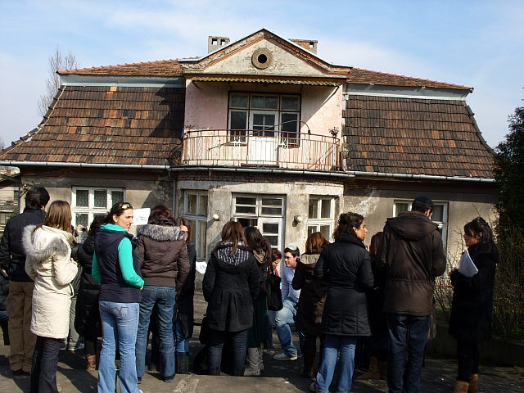
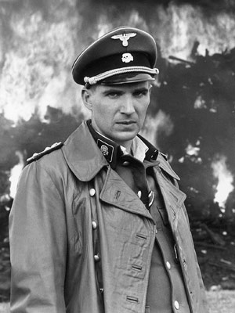
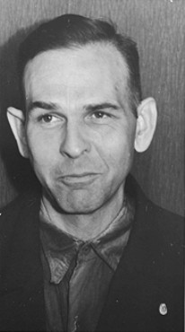
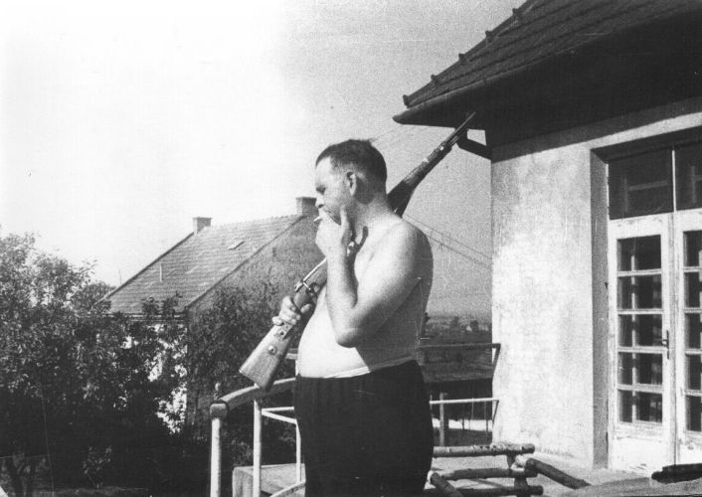
Amon Goeth

Slide 12
The Global Conflict: Allied Successes
The Co-Prosperity Sphere
Japan created the Great East Asia Co-Prosperity Sphere
Used the slogan “Asia for Asians” – said they would help Asians escape western colonial rule
Japan’s goal – empire in Asia
Japan tortured, killed Chinese and other conquered people, seized food crops, made local people into slave laborers
Notes:
We’re not here to conquer you, we are your brothers
Can anyone come up with a slogan that they know of?
The Rape of Nan king
It is a horrible story to relate; I know not where to begin nor to end. Never have I heard or read of such brutality. Rape: We estimate at least 1,000 cases a night and many by day. In case of resistance or anything that seems like disapproval there is a bayonet stab or a bullet. (James McCallum, letter to his family, 19 December 1937)
Robert Wilson in his letter to his family: The slaughter of civilians is appalling. I could go on for pages telling of cases of rape and brutality almost beyond belief. Two bayoneted corpses are the only survivors of seven street cleaners who were sitting in their headquarters when Japanese soldiers came in without warning or reason and killed five of their number and wounded the two that found their way to the hospital. ^{[11]}
Quite contrary to their slogan

Slide 13
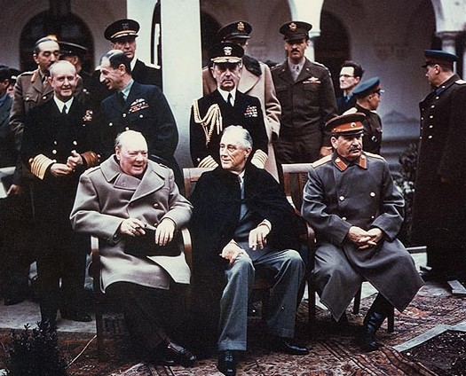
The Global Conflict: Allied Successes
The Allied War Effort
The Big Three – FDR, Churchill, Stalin – 1942 – agreed to finish war in Europe before finishing war in Asia with Japan

Slide 14
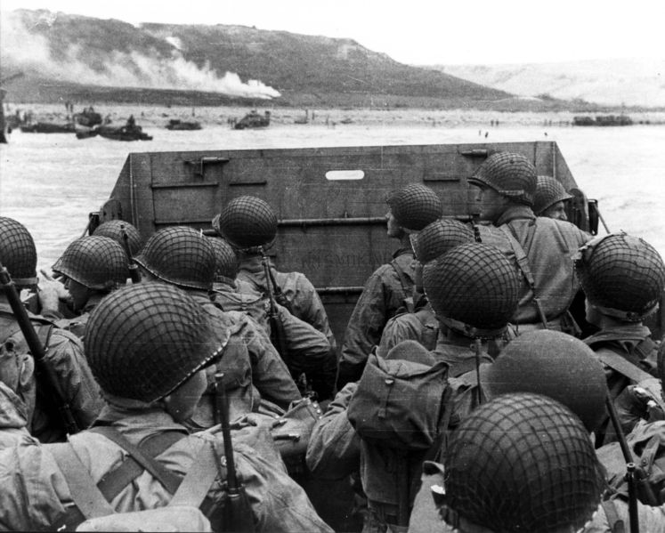
The Global Conflict: Allied Successes
1. 1944 – D-Day – opening of 2nd front in Western Europe
Stalin thought this was a deliberate policy (by Britain, U.S.) to weaken the Soviet Union
Notes:
Show Hitler’s Atlantic Wall and explain Dover, Patton and Normandy
Talk about Patton’s fake army

Slide 15
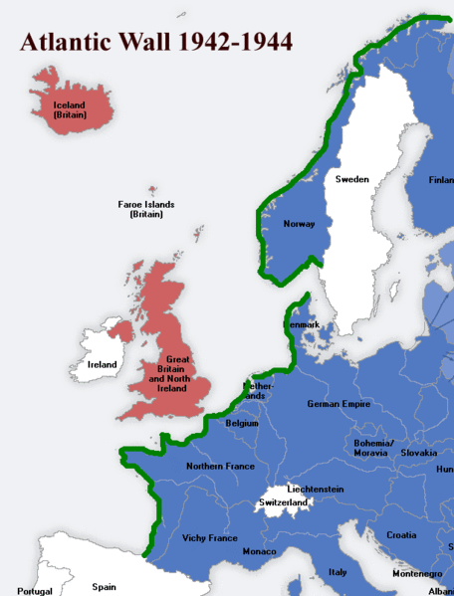

Slide 17
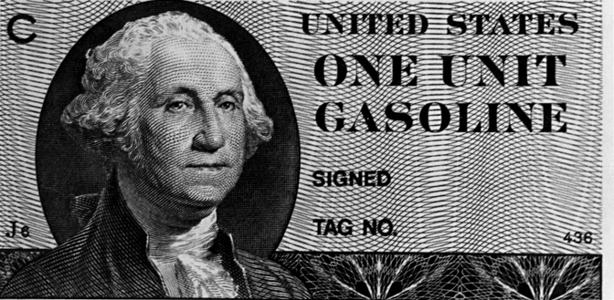
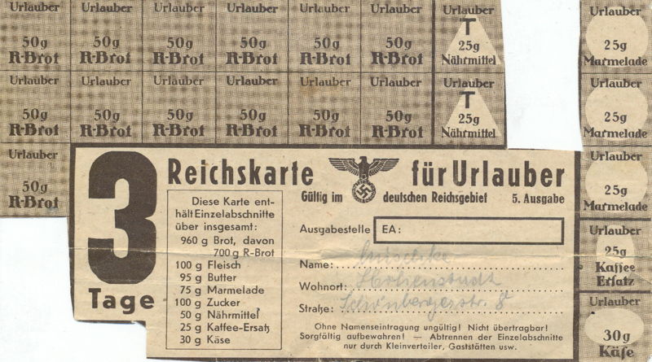
The Global Conflict: Allied Successes
B. Total War
1. Britain, U.S. directed economic resources into the war effort
a. factories switched from consumer goods production to war production
b. govt. rationed consumer goods, regulated gas prices + wages
c. war ended unemployment of the depression era
Notes:
WWI also a total war
Is the War in Iraq a total war?
Rubber, nylons
25% unemployment erased. Today we are at 11% technically

Slide 18
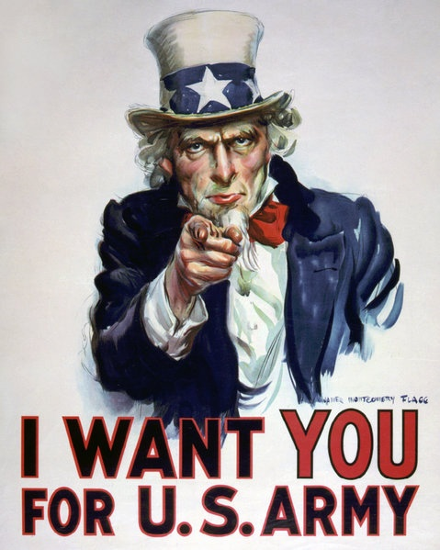
The Global Conflict: Allied Successes
Democratic govts. Censored press, used propaganda to win public support, limited citizens’ rights
a. Japanese in U.S. + Canada sent to internment camps when govt. saw them as a security risk
Bugs Bunny
Notes:
Show Ducktators
Song, “Praise the lord and pass the ammunition” compare to “boot in your ass” by Toby Keith

Slide 19
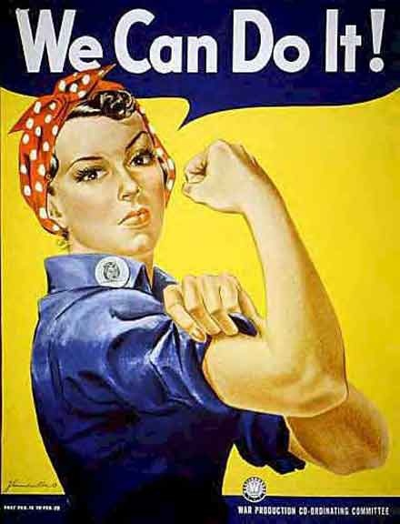
The Global Conflict: Allied Successes
Women + The War Effort
Millions of women replaced men in essential jobs
Worked in war industries, staffed offices, served in armed forces in non-combat roles
European women fought in resistance groups against the Axis
Rosie the Riveter
Notes:
Rosie the Riveter

Slide 20
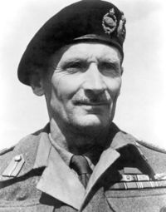
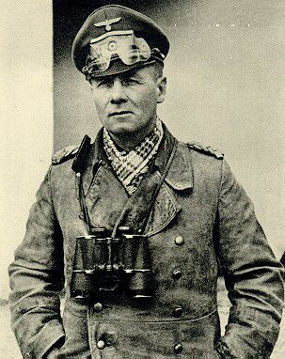
III. Turning Points
El Alamein, Egypt – 1942
British General Bernard Montgomery stopped Rommel’s advance in Egypt
U.S. General Dwight Eisenhower led Anglo-U.S. force from the west (Morocco, Algeria) – Rommel’s army trapped in Tunisia, surrendered in May 1943
Notes:
Who does Monty fight for?
Who does Rommel fight for?
Fighting in North Africa was primarily fought with tanks
Story about Rommel’s death
Rommel on Italians "Good troops, bad officers. But remember that without them we wouldn't have civilization."
Churchill states "This is not the end, nor is it even the beginning of the end, but it is, perhaps, the end of the beginning."

Slide 21
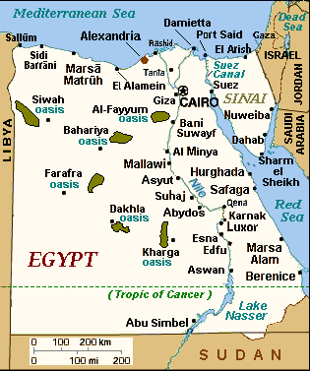
Notes:
What major water way was key to this battle? Suez

Slide 22
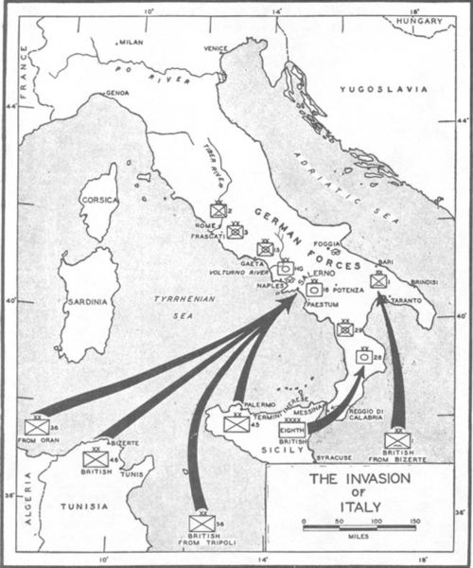
III. Turning Points cont.
B. Invasion of Italy – 1943
1. U.S. + British troops landed in Sicily + southern Italy, defeated Italian forces one month later
Notes:
Soft Under belly – Allies wanted to trap German forces
Where is Sicily?

Slide 23
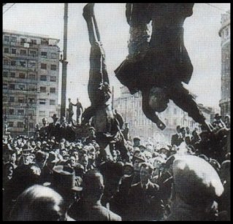
III. Turning Points cont.
2. Mussolini went into hiding, new Italian govt. signed armistice, fighting in Italy between Germans + Allies continued for 18 months – Allies took control of Italy
3. Importance of invasion: Hitler forced to fight on another front
Notes:
Mussolini and his mistress were shot and hung on meat hooks in Milan as a display of what was going to happen to Fascists.
Italy soon joins the side of the Allies after Mussolini’s death

Slide 24
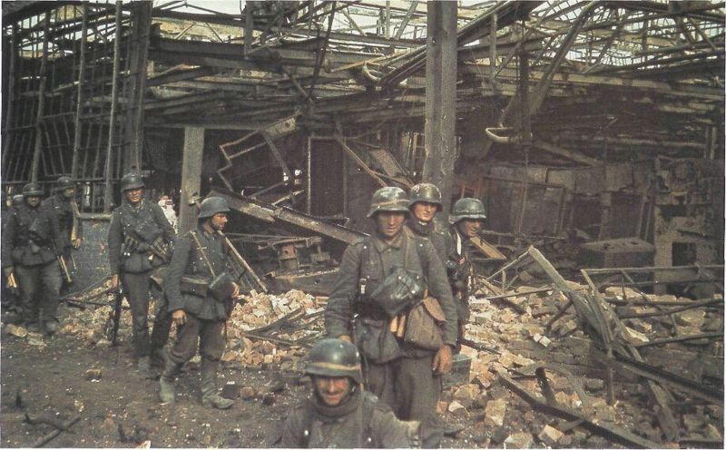
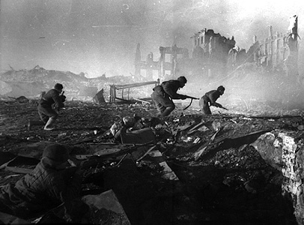
IV. Red Army Resists
Stalingrad
Germans surrounded city, Russians surrounded Germans
Harsh winter weather killed thousands
Germans surrendered in early 1943 – 300,000 Germans killed, wounded, or captured
Call of Duty
Notes:
Devastating to both sides

Slide 25
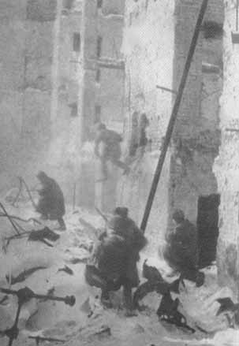
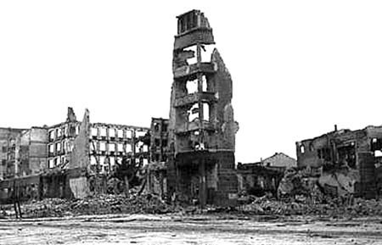
IV. Red Army Resists cont.
Counterattack
1. Red Army took the offensive after Battle of Stalingrad, drove Germans into Eastern Europe
Notes:
199 day battle
Axis casualties 850,000
Soviet Casualties 1,129,000
Including 50,000 turncoat Russians
Original call of duty – battle of Stalingrad
One gun for 2 soldiers
One bullet a day
Severe lack of resources, ammo, guns etc.

Slide 26
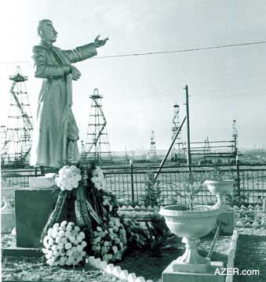
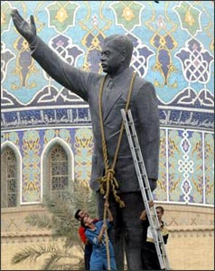
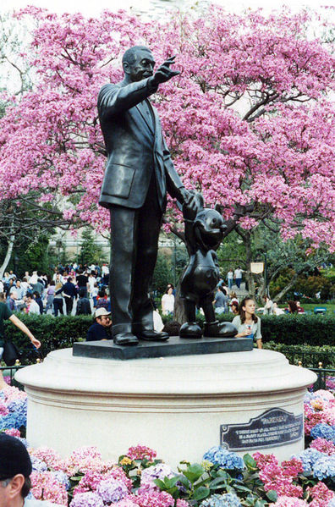
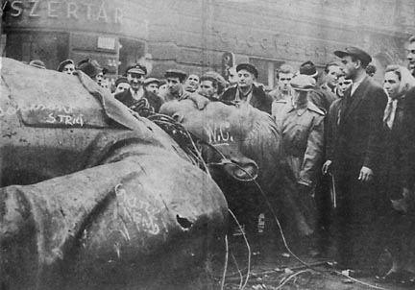
Notes:
Similar statues
Stalin, Hussein, Disney????

Slide 27
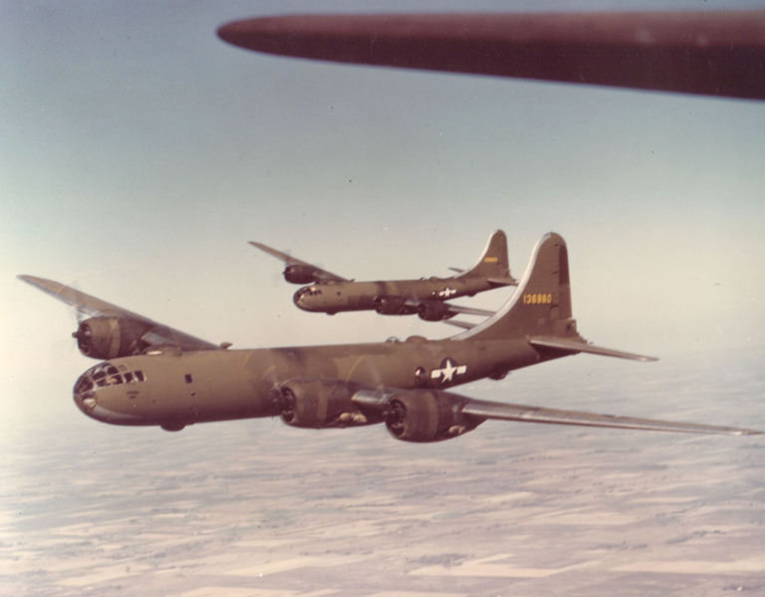
V. Invasion of France
Before invasion, Allied bombers flew constant missions over Germany
Destroyed factories + aircraft that might be used against invasion force
Many German cities destroyed
Notes:
B-29 Superfortress
Talk about hills created out of debris in Germany
Talk about the bombing of Dresden and the incendiary bombs

Slide 28
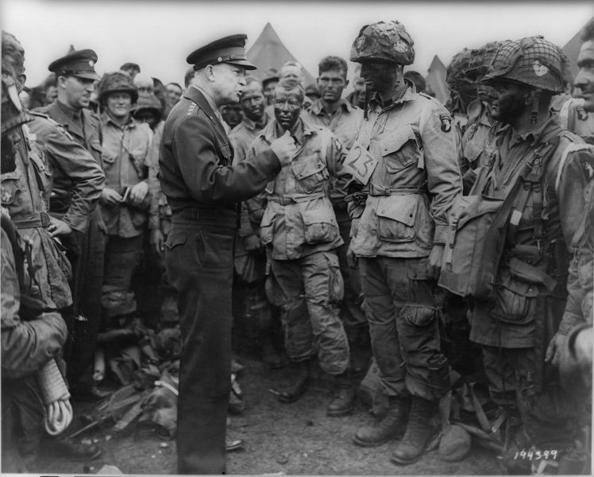
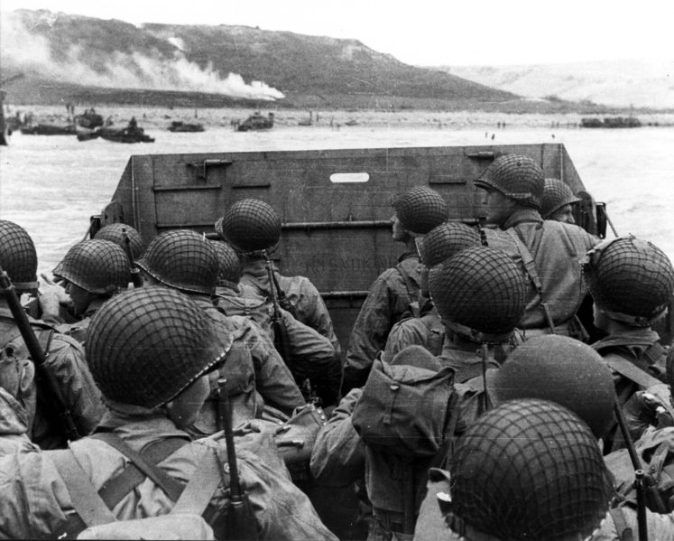
V. Invasion of France cont.
B. D-Day – June 6, 1944 – invasion of France
1. 176,000 Allied troops ferried across English Channel to the beaches of Normandy – faced heavy fire from German forces
2. Allies broke through German defenses, began advanced toward Paris
Notes:
Paratroopers – gliders, rupert
DD tanks
5 beaches, Omaha, Utah, Sword, Juno, Gold

Slide 29
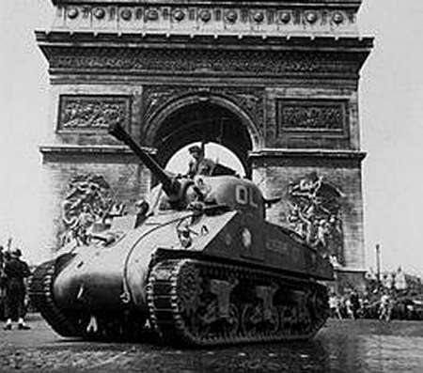
V. Invasion of France cont.
3. Allied forces sailed from Italy, invaded Southern France
4. August 1944 – Allies entered Paris – Sept. – France liberated
Notes:
Who was in Southern France? Vichy

Slide 30
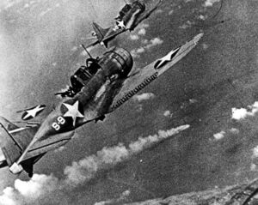
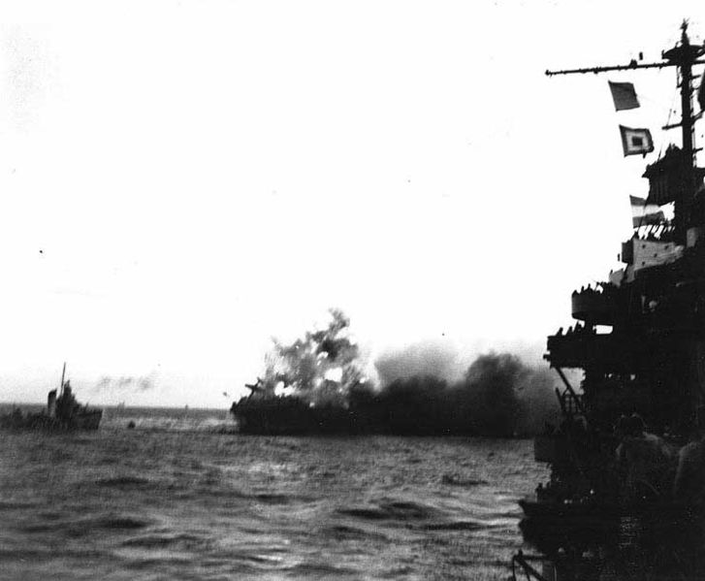
Toward Victory
War in the Pacific
Major turning point – May/June 1942
US warships, airplanes severely damaged two Japanese fleets during battles of Coral Sea and Midway
These victories weakened Japanese naval power, stopped their advance

Slide 31
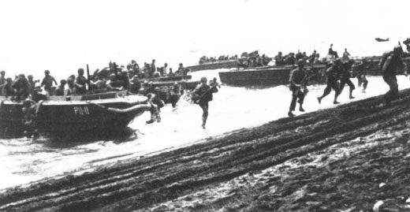
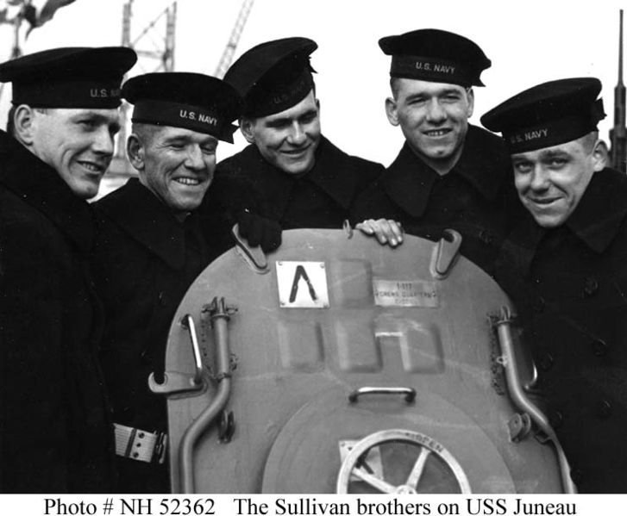
I. War in the Pacific cont.
2. US now took the offensive
a. US Marines, led by General Douglas MacArthur, landed at Guadalcanal in the Solomon Islands
Notes:
Guadalcanal was very costly for both sides
Japanese wiped out in this battle
Sullivan Brothers

Slide 32
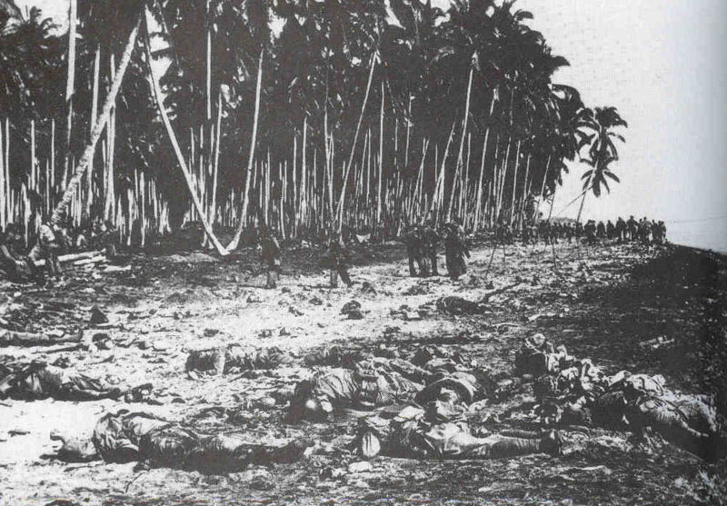

Slide 33
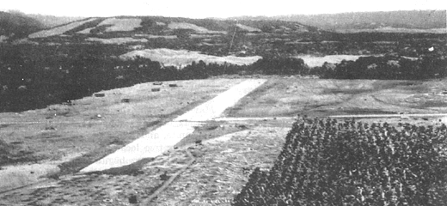
I. War in the Pacific
Beginning of “Island Hopping” campaign – capture Japanese held islands, use as stepping stones to next objective
US built air bases on captured islands
1944 – US blockade of Japan, US bombers pounded Japanese cities and industries, MacArthur began to retake the Philippines
Notes:
We wanted to get closer to Japan so we could bomb and possibly invade it.

Slide 34
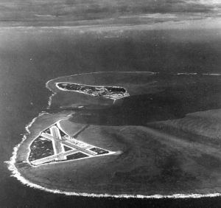
Notes:
Midway

Slide 35
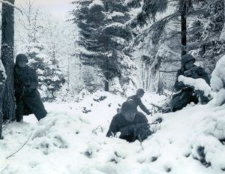
II. The Nazis Defeated
Battle of the Bulge – Belgium – Dec. 1944
Hitler launched massive counterattack against allies
Both sides – terrible losses
Hitler slowed Allied advance (temporarily)
Notes:
Extreme weather conditions
Hitler’s last major offensive

Slide 36
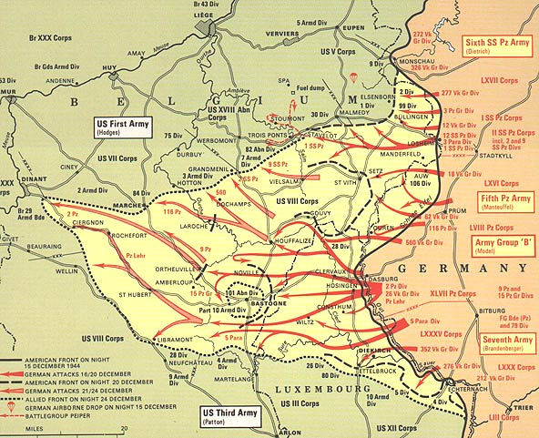
Notes:
What country are we in?
Why do you think they called it the Battle of the Bulge?

Slide 37
II. The Nazis Defeated cont.
B. The Air War
1. Germany under constant bombing
2. Raids on Dresden – Feb. 1945 – 135,000
Notes:
Tell of microwave and asphyxiation

Slide 38
II. The Nazis Defeated cont.
On to Berlin
March 1945 – Allies crossed Rhine River into Western Germany, Red Army closed in on Berlin from the East
April 1945 – Mussolini captured – executed, Hitler committed suicide
Notes:
Eisenhower let the Russians have Berlin so they discovered Hitler’s body
Tell story of Hitler’s suicide as well as Russian documents that say what happen to the bodies
Blondi, Eva Braun, suicide and body
Also talk about Goebbels and his children

Slide 39
II. The Nazis Defeated cont.
3. May 7th, 1945 – Germany surrendered, May 8th is VE day – Victory in Europe
Notes:
Who’s this guy in the picture?
Talk about the difference between the peace sign and the victory sign

Slide 40
III. Defeat of Japan
A. Invasion vs. the Bomb
1. invasion of Japan might cost a million or more casualties on both sides
2. development of the atomic bomb (the Manhattan Project)
Notes:
Operation Downfall
Manhattan project. Who was behind it?
Albert Einstein and Robert Oppenheimer. Most people regretted their part in the MP
Who is the President at this time? Truman
Truman had no idea about the A-bomb until he became president
FDR sanctioned the project

Slide 41
Notes:
Operation Downfall

Slide 42
III. Defeat of Japan
3. July 1945 – 1st successful test in New Mexico
4. Potsdam Conference – Allied nations met in Germany to make plans for post-war Europe – Pres. Truman issued warning to Japan: surrender or face “utter and complete destruction”
Notes:
Ask students what three scenarios would cause more damage, underground, on the ground above the ground
Talk about how the bomb exploded several thousand feet in the air to cause more destruction

Slide 43
III. Defeat of Japan
B. Hiroshima
1. Aug 6th, 1945 – A-bomb dropped on Hiroshima – flattened 4 square miles, instantly killed 76,000 people
2. Aug 8th, 1945 – USSR declared war on Japan, invaded Manchuria
3. Japan refused to surrender, 2nd bomb dropped on Nagasaki on Aug 9th
Notes:
USS Indianapolis story – Jaws clip if time
Talk about shadow burned into the wall

Slide 44
“Little Boy” & “Fat Man”

Slide 45
III. Defeat of Japan cont.
Sept. 2nd – formal surrender signed in Tokyo Bay on the USS Missouri
Notes:
Bookends of the war

Slide 46
III. Defeat of Japan
C. Why use bomb?
1. Truman – only other option was to invade Japan, costing enormous losses
2. he may have hoped the bomb would impress the Soviets with American Power
Notes:
Tell them about book pages 791, 792 – Aftermath 75 million dead – Rudolf Hess Auschwitz death camp commander – Nuremburg Trials – United Nations and the security council – preventing outbreak and disease etc. – Know your North Africa Maps page 785

